Slide 1
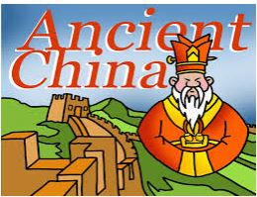
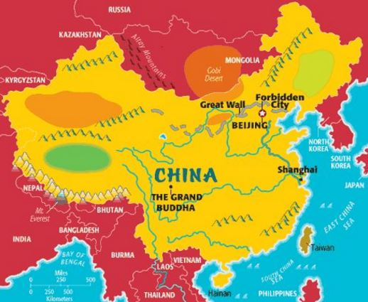
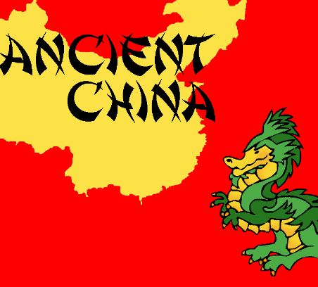
Ancient China
By Gabi, Nicole, and Sebastian

Slide 2
Geography in Ancient China
The ancient Chinese people knew there were other tribes in the north, but they did not know that there were more civilizations spread across the world. They were isolated and separated by natural barriers.
To both of their sides, China bordered two seas. The China Sea and the Yellow Sea. Even though the oceans provided food, water and routes to trade, they are both in the Pacific Ocean. That ocean is pretty big so a few Chinese claimed to explore it someday.

Slide 3
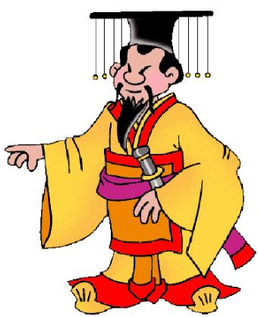
Clothing in Ancient China
The people who lived in ancient China wore tunics. Some of the people wore pants under their tunics. When it was cold some people wore short jackets that were warm. The people didn’t care what the color of there clothes were as long as they did their work. One time an emperor said that peasants weren’t allowed to wear clothes with bright colors. Most of the farmers there wore clothes that are dark blue or gray. In ancient China there was a big difference between poor and rich.

Slide 4
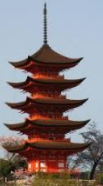
Architecture: Pagodas
During the Han times the idea of pagodas came to China from India. The pagoda’s roof is shaped like a mountain with peaks. Their love beauty and nature was reflected in their architecture, even in the most humble homes.

Slide 5
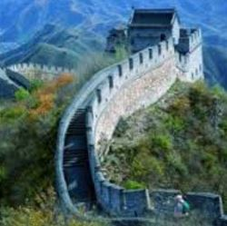
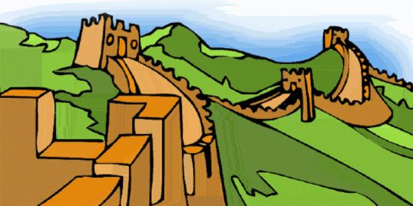
Architecture: The Great Wall of China
The first Emperor Qin was only emperor for 15 years. But in that time , he made amazing changes. It was under his rule that China became a country. The emperor wanted to strengthen China’s protection from Mongol tribes to the north. So he told people to build the Great Wall of China. Most of the wall was built between 220 – 206 BC.

Slide 6
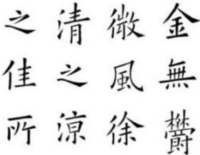
Writing in Ancient China
The ancient Chinese use a very different hand writing system then we do. They use a sign or symbol to represent a word. The basics at it is that they haven’t changed their writing in thousands of years. Every character is a number of lines or strokes or lines in imaginary squares.

Slide 7
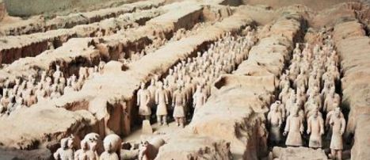
Government
In ancient China the ruling government was called a dynasty. The emperor was cut off from the ordinary people (peasants). The dynasty called Shang dynasty is the oldest in the world. Their were thirty kings who all ruled during the Shang dynasty.
Shi Huangdi (an emperor) had life sized terra cotta soldiers put in his tomb for protection.

Slide 8
School in Ancient China
School was free for boys during the Han Dynasty, but at one point all of them where enrolled or brought out of school. Whether they were from rich or poor families, the girls could not attend school. It was against the rules at all schools and it was very rare to find a family that taught their daughters at home. In the Tang times, people came from far away lands such as India and Korea to learn the arts of China. Special rooms in the Imperial Palace were for training.

Slide 9
Culture: Art
The art of ancient China was really pretty. Some people came from far away to study Chinese art. Some art forms in China are still in use today such as calligraphy (the art of writing beautiful), embroidery (work or ornamentation), paintings, statues, buildings, shrines (a building or other shelter) porcelain (ware made from this) silk and more.

Slide 10
Culture
The holiday Chinese new year is so important to china. The celebration after the Chinese new year is the lantern festival. The lantern festival started about 3,000 years ago.

Slide 11
Toys in Ancient China
The children of the ancient Chinese played with many toys. To name a few ,they played with colorful marbles, little wooden animals and dragons, puppets, masks, roly - poly figures, and kites.
They also had toys that made noises. For example, they played with whistles, flutes made out of bamboo, red pipes and colorful rattles. While the boys played with swords, the girls played with baby dolls. They also played a game similar to checkers.

Slide 12
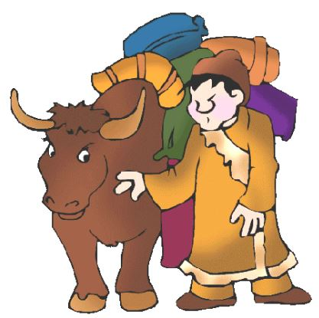
Daily Life
In ancient China, people held different social classes.
Scholars were on top.
Artist were admired by their work.
Merchants were on the bottom of the social chart in Ancient China.
A lot of people were farmers. For them it was a hard life.
Rich people in Ancient China ate very well , they ate Ducks, Chicken, Goose and Dog they also ate Fish and Sea slugs.

Slide 13
Contributions
Gunpowder, paper, printing and the compass were the four greatest inventions in Ancient China.
Kites were the first used for the army for a warning signals.
Umbrellas were invented to protect people from rain or sun.
Ancient China has the longest man–made canal in the world.
The invention of abacus in the 2nd century BC.
They discovered gunpowder which was used to make bombs, guns , mines, and rockets.
Wood block was invented in AD 868 and then moveable type around 200 years later .
Paper was invented by the Ancient Chinese people and the first paper was invented on the 2nd century BC and manufactured 195 BC.

